Slide 1
Machine learning with Azure machine learning with R extension
Dr. Uros Godnov

Slide 2
Before we start
Machine learning is suddenly very popular
All non-scientist and non-statisticians are now data scientist
Very easy to accomplish something
No knowledge needed for „something“ to do „something“ that returns „something“

Slide 3
Machine learning
Machine learning is a type of artificial intelligence (AI) that provides computers with the ability to learn without being explicitly programmed.
Similar to data mining, but there is a difference!
„Hierarchy“:
Statistics quantifies numbers
Data Mining explains patterns
Machine Learning predicts with models
Artificial Intelligence behaves and reasons

Slide 4
Machine learning
Facebook's News Feed uses machine learning to personalize each member's feed.
WolframAlpha engine
R or Phyton

Slide 5
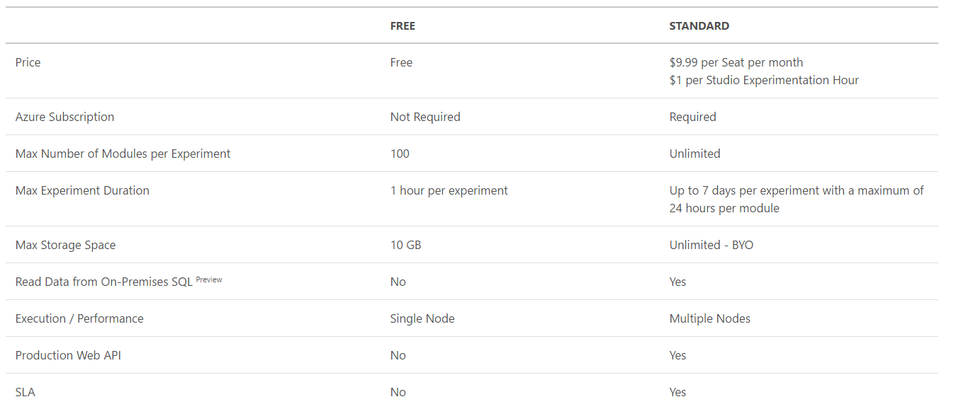
Azure machine learning (free version)

Slide 6
Types of data
Plain text (.txt)
Comma-separated values (CSV) with a header (.csv) or without (.nh.csv)
Tab-separated values (TSV) with a header (.tsv) or without (.nh.tsv)
Hive table
SQL database table
OData values
SVMLight data (.svmlight)
Attribute Relation File Format (ARFF) data (.arff)
Zip file (.zip)
R object or workspace file (.RData)

Slide 7
Variables

Slide 8
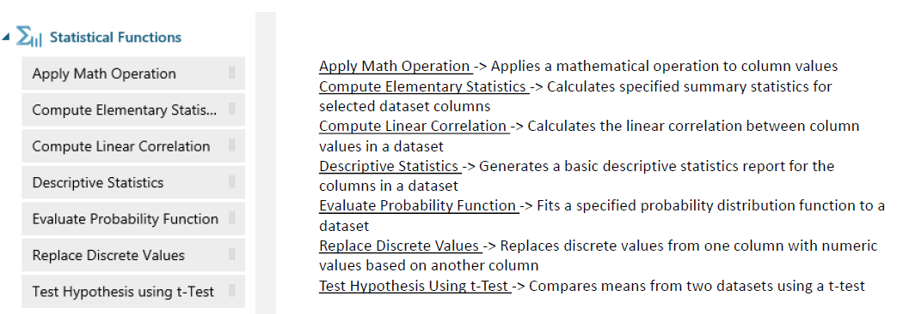
General statistics

Slide 9
Demo 1
Automobile price data
Select column (length, horsepower, city-mpg, highway-mpg, price)
Summarize data
Compute linear correlation
Notes:
If there will be error: at least one all layer data -> problem in name->special character

Slide 10
Extensions – data preparation phase
Pyhton extension
R extension:
ggplot2
Preparing data
print(rownames(installed.packages()))

Slide 11
Back to previous example
Add Execute R script task
Inside task add the following:
library(PerformanceAnalytics)
chart.Correlation(dataset1)

Slide 12
R (visualization) – ggplot2
ggplot2 → golden standard for plots in R
Vizualizing using a „grammar“:
Data
Chart type
Smoothing curve
Facets
Calculated columns with function within

Slide 13
R – ggplot2
install packages ggplot2 and reshape2, dplyr
Show „tips“ data set
Add calculated column ratio
Show scatterplot(total_bill,ratio)
Expand basic graph with sex/time
Add smooth linear curve
Notes:
Pokaži tips <- reshape environment in klikni pri tips
Tips<-within(tips, ratio<-tip/total_bill
plot<-ggplot(tips, aes(x=total_bill, y=ratio))+geom_point(shape=1)+facet_grid(time~sex)
plot<-plot+geom_smooth(method=lm, se=FALSE)
print(plot)

Slide 14
Demo 1/a
Select columns
Edit metadata
Execute R script

Slide 15
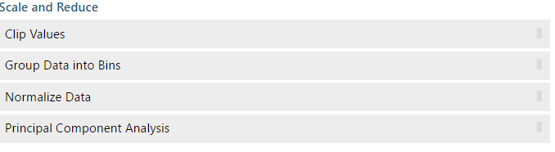
Data manipulation/transformation

Slide 16
Demo 1/b
Group into bins
Split data:
random
stratified

Slide 17
Now, we are ready!

Slide 18
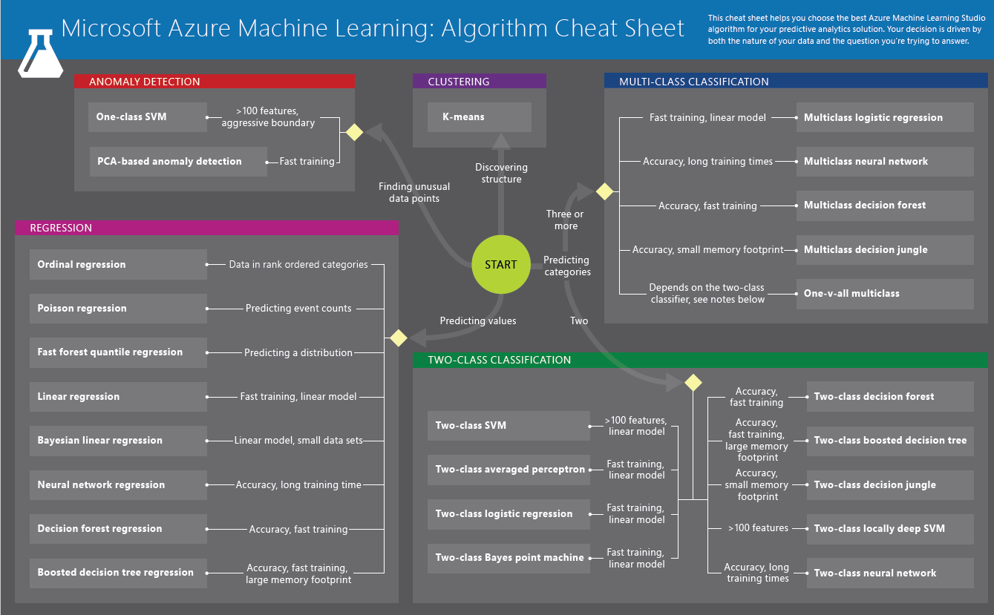

Slide 19
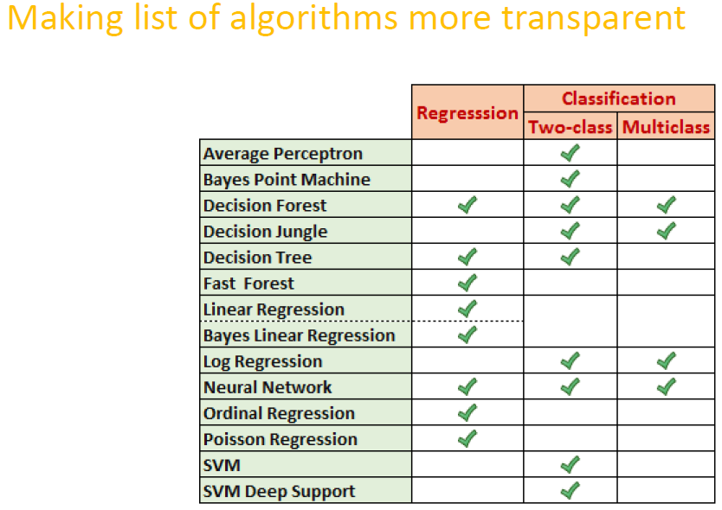

Slide 23
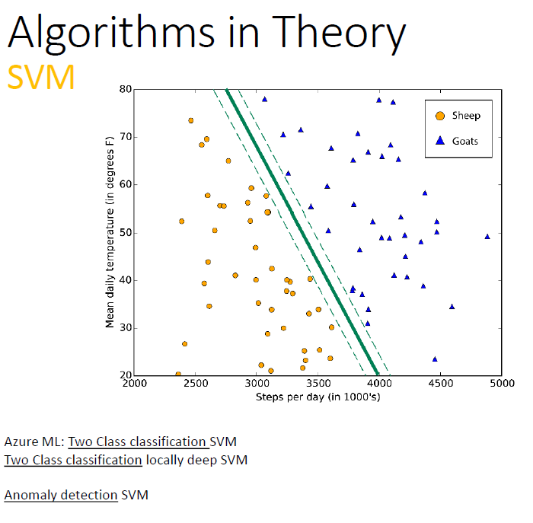

Slide 24
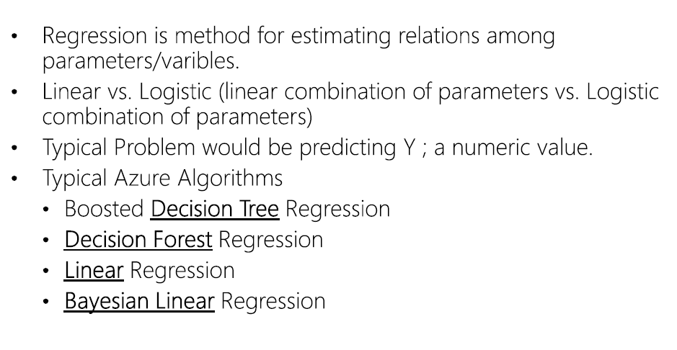
Regression algorithms

Slide 25
Notes:
Bagging – bootrap sampling → many samples and then mean
The training algorithm for random forests applies the general technique of bootstrap aggregating, or bagging, to tree learners. Given a training set X = x₁, ..., x_{n} with responses Y = y₁, ..., y_{n}, bagging repeatedly (B times) selects a random sample with replacement of the training set and fits trees to these samples:
You can use the Boosted Decision Tree Regression module to create an ensemble of regression trees using boosting. Boosting means that each tree is dependent on prior trees, and learns by fitting the residual of the trees that preceded it. Thus, boosting in a decision tree ensemble tends to improve accuracy with some small risk of less coverage.

Slide 26
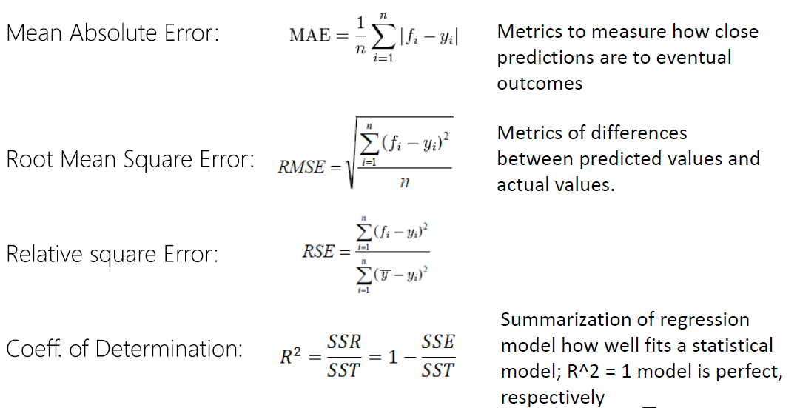
Evaluating regression algorithms

Slide 27
Demo 1/c
Regression model
Score
Evaluation

Slide 28
Comparison of Regression Algorithms

Slide 29
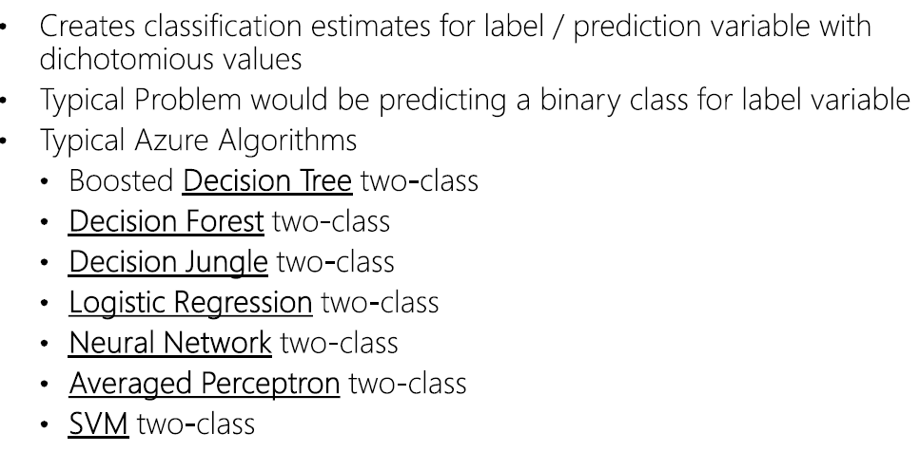
Two-class clasification

Slide 30
Notes:
A boosted decision tree is an ensemble learning method in which the second tree corrects for the errors of the first tree, the third tree corrects for the errors of the first and second trees, and so forth. Predictions are based on the entire ensemble of trees together that makes the prediction. (Tune Model Hyperparameters)
Decision jungles have the following advantages:
By allowing tree branches to merge, a decision DAG typically has a lower memory footprint and better generalization performance than a decision tree, albeit at the cost of somewhat longer training time.
Decision jungles are non-parametric models that can represent non-linear decision boundaries.
They perform integrated feature selection and classification and are resilient in the presence of noisy features.
Two-Class Support Vector Machine - The classifier that this module initializes is useful for predicting between two possible outcomes that depend on continuous or categorical predictor variables.
Understanding the Averaged Perceptron Model - In this supervised learning method, inputs are classified into several possible outputs based on a linear function, and then combined with a set of weights that are derived from the feature vector—hence the name "perceptron."

Slide 31
Regularization weight
Notes:
To summarize, L1 regularization sometimes has a nice side effect of pruning out unneeded features by setting their associated weights to 0.0 but L1 regularization doesn’t easily work with all forms of training. L2 regularization works with all forms of training, but doesn’t give you implicit feature selection. In practice, you must use trial and error to determine which form of regularization (or neither) is better for a particular problem.

Slide 32
Evaluating two-class Classification

Slide 33
Evaluating two-class Classification

Slide 34
Demo 2
Adult Census Income Binary Classification dataset
Download dataset and create ggplot in R
Focus only on USA
Omit fnlwgt, education-num, capital-gain, capital-loss

Slide 35
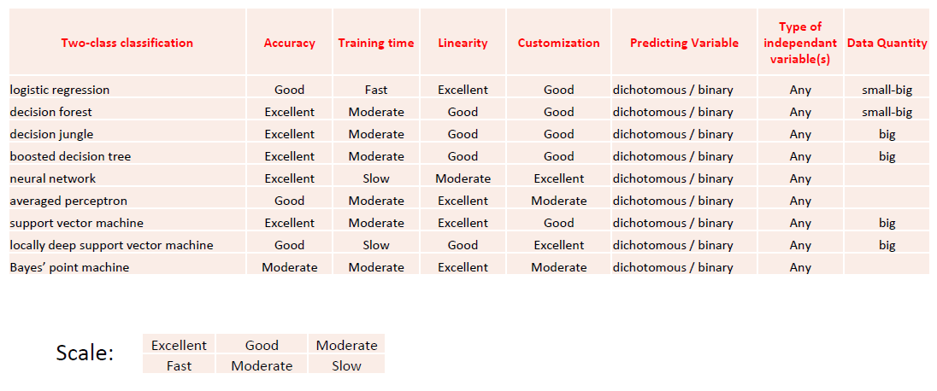
Comparison of Two-class Classification Algorithms

Slide 36
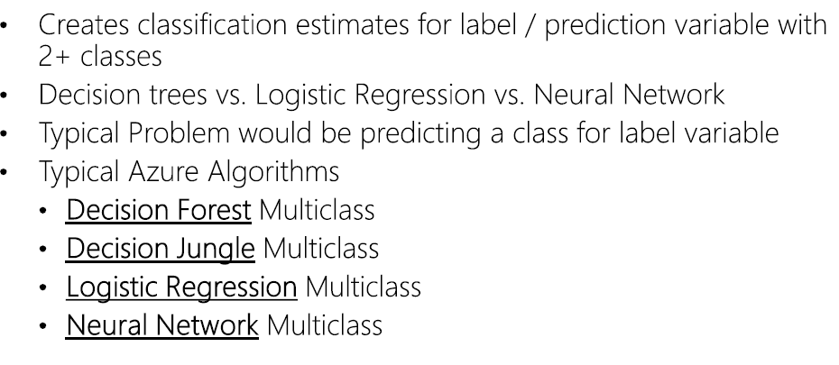
Multi-class Classification

Slide 37
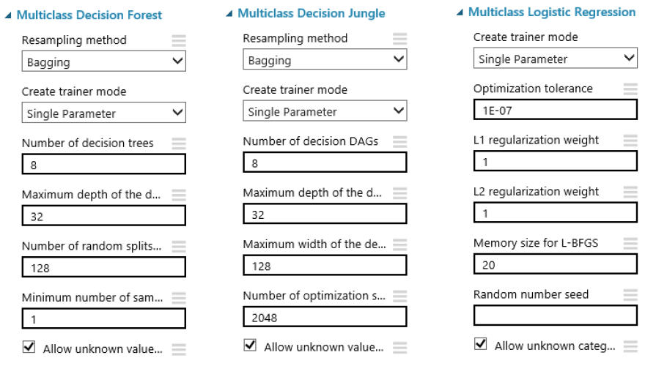

Slide 38
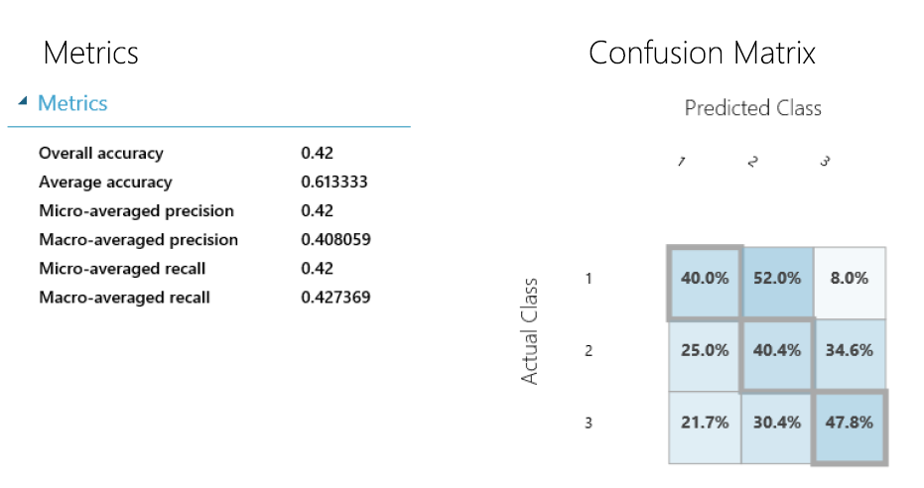
Evaluating multi-class Classification

Slide 39
Demo 3
Iris_multi

Slide 40
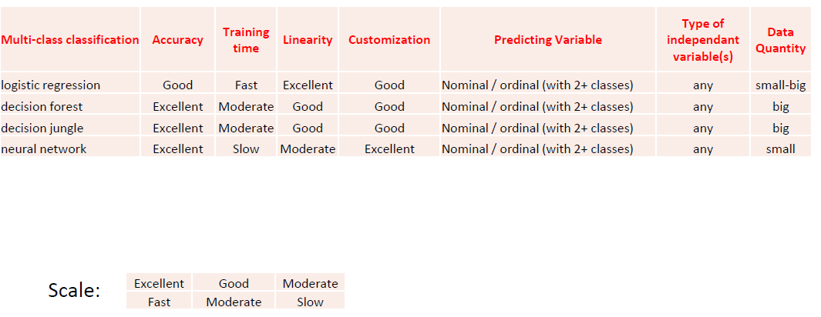
Comparison of Multi-class Classification Algorithms

Slide 41
Good to know!
Importing large dataset → zip it → upload
When using it → use Unpack zipped datasets

Slide 42
Webservice
Publish model as webservice
Deploy it and connect with excel via Machine learning add-in

Slide 43
Jupiter Notebook
Jupyter notebooks provide an interactive environment for exploring data and collaborating with other data scientists.
Jupyter.org
When running in Azure ML, we don‘t need to worry about security
50 kernells available

Slide 44
Jupyter Notebook
3 types of cells:
Code
Raw
Markdown
In Azure ML – only csv files
To run code (ctrl+enter)

